Slide 1

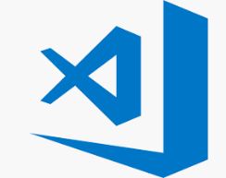

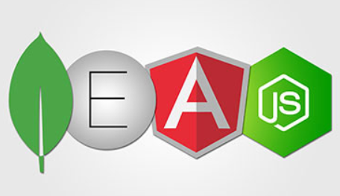
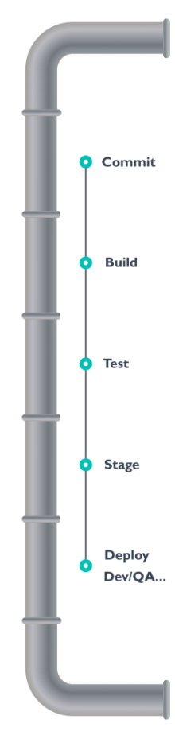


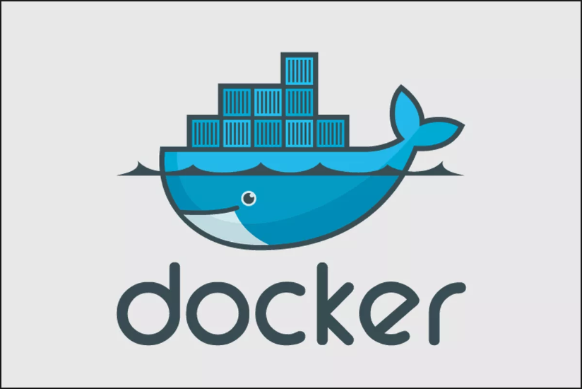
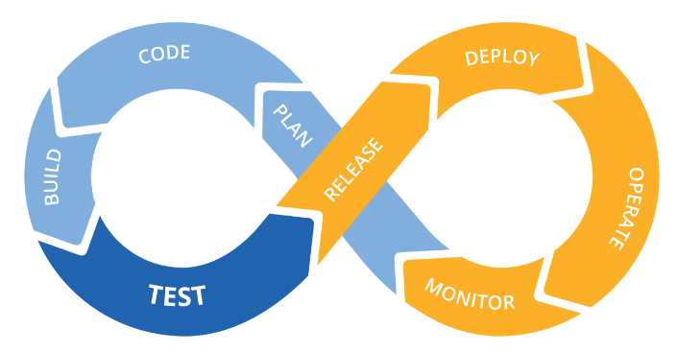
Containerized MEAN Stack Development through a CI/CD pipeline
Mike Sellers - Container Zealot and Senior Software Engineer
Ali Soylu – Developer and IT Architect
Johns Hopkins University
May 29, 2019

Slide 2
Agenda
OBJECTIVE: To review CI/CD Architecture and share a containerized MEAN stack development lifecycle through a CI/CD pipeline.
Part 1 – Architecture and Design
What is DevOps
What is CI/CD
CI/CD Pipeline Architecture
Developer workstation (Docker CE - https://docs.docker.com/install/)
Code repository (GitHub - https://github.com/jhuopensource/meandemo)
Continuous Integration (Travis-CI - https://travis-ci.com/)
Testing
Linting (https://en.wikipedia.org/wiki/Lint_(software))
Selenium browser automated testing (https://www.seleniumhq.org/)
Container repository (Docker Hub - https://hub.docker.com/)
Docker Swarm (https://docs.docker.com/engine/swarm/)
MEAN Demo Project Stack Architecture
NGINX – WebServer for static content, load balancer and proxy for dynamic content (https://hub.docker.com/_/nginx/)
MongoDB – Database (https://www.mongodb.com/)
ExpressJS – JavaScript back-end web framework (API - https://expressjs.com/)
AngularJS – JavaScript frontend framework for MVC (https://angularjs.org/)
NodeJS – JavaScript client runtime environment (https://nodejs.org/en/)
Part 2 – One MEAN CI/CD Docker Demo

Slide 3

What is DevOps
Defined
“DevOps is the combination of cultural philosophies, practices, and tools that increases an organization’s ability to deliver applications and services at high velocity: evolving and improving products at a faster pace than organizations using traditional software development and infrastructure management processes. This speed enables organizations to better serve their customers and compete more effectively in the market.” – Amazon https://aws.amazon.com/devops/what-is-devops/
How DevOps Works
“Under a DevOps model, development and operations teams are no longer “siloed.” Sometimes, these two teams are merged into a single team where the engineers work across the entire application lifecycle, from development and test to deployment to operations, and develop a range of skills not limited to a single function.” – Amazon https://aws.amazon.com/devops/what-is-devops/

Slide 4
What is a CI/CD
Continuous Integration (CI) Defined
“The technical goal of CI is to establish a consistent and automated way to build, package, and test applications. With consistency in the integration process in place, teams are more likely to commit code changes more frequently, which leads to better collaboration and software quality. … A mature CI/CD practice has the option of implementing continuous deployment where application changes run through the CI/CD pipeline and passing builds are deployed directly to production environments.” – InfoWorld https://www.infoworld.com/article/3271126/what-is-cicd-continuous-integration-and-continuous-delivery-explained.html
Continuous Deployment (CD) Defined
“Continuous delivery picks up where continuous integration ends. CD automates the delivery of applications to selected infrastructure environments.” – InfoWorld https://www.infoworld.com/article/3271126/what-is-cicd-continuous-integration-and-continuous-delivery-explained.html

Slide 5
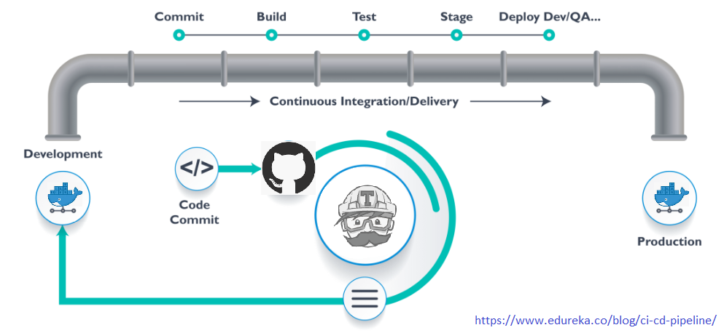

CI/CD Pipeline Architecture

Slide 6
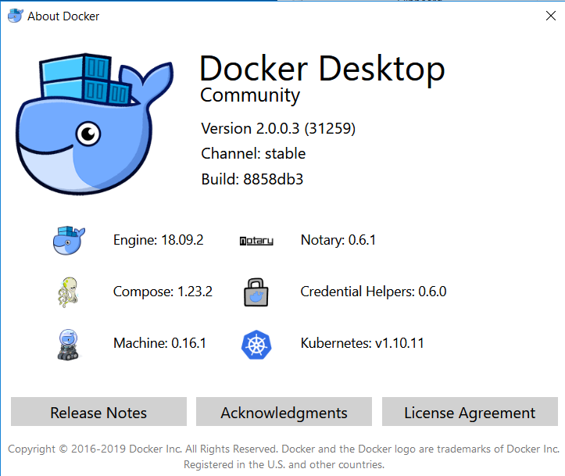
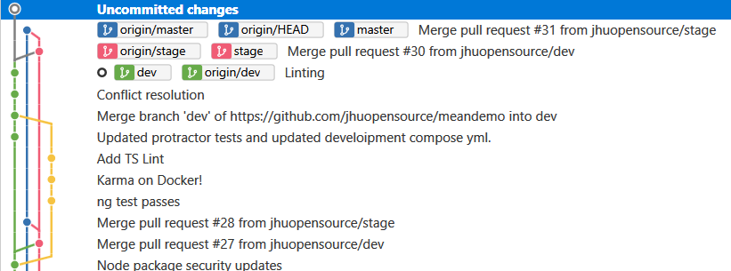
CI/CD Pipeline Architecture
Commit
“Let’s take a scenario of CI CD Pipeline. Imagine you’re going to build a web application which is going to be deployed on live web servers. You will have a set of developers who are responsible for writing the code which will further go on and build the web application. Now, when this code is committed into a version control system(such as git, svn) by the team of developers” – edureka https://www.edureka.co/blog/ci-cd-pipeline/
Demo Tooling
Development Workstation
Docker CE
Visual Studio Code
Git Cli / Sourcetree
Version Control
Github.com -> https://github.com/jhuopensource/meandemo
Dev, Stage and Master branches
Docker Hub -> https://hub.docker.com/r/jhuopensource/meandemo
Docker Stack / Service (see docker-compose-stack.yml update_config, parallelism, …)

Slide 7
CI/CD Pipeline Architecture
Build
“Suppose we have a Java code and it needs to be compiled before execution. So, through the version control phase, it again goes to build phase where it gets compiled. You get all the features of that code from various branches of the repository, which merge them and finally use a compiler to compile it. This whole process is called the build phase.” – edureka https://www.edureka.co/blog/ci-cd-pipeline/
Demo Tooling (demo url: http://meandemo.sis.jhu.edu)
CI Automation
Travis-CI (runs build, test and stage / deploy)
Docker

Slide 8
CI/CD Pipeline Architecture
Test
“Once the build phase is over, then you move on to the testing phase. In this phase, we have various kinds of testing, one of them is the unit test (where you test the chunk/unit of software or for its sanity test).” – edureka https://www.edureka.co/blog/ci-cd-pipeline/
Demo Tooling (demo url: http://meandemo.sis.jhu.edu)
CI Automation
Travis-CI (runs automated testing)
Linting (style, format, structure, …)
Selenium Browser Automated Testing

Slide 9
CI/CD Pipeline Architecture
Stage Deploy
“When the test is completed, you move on to the deploy phase, where you deploy it into a staging or a test server. Here, you can view the code or you can view the app in a simulator. ” – edureka https://www.edureka.co/blog/ci-cd-pipeline/
Demo Tooling (demo url: http://meandemo.sis.jhu.edu)
Image repository
Docker Registry
CI Automation
Travis-CI (runs automated deployment to stage the built code)
On merge to production (and pending automated test success) push latest version to the Docker Registry
NOTE: Additional security scanning may be enabled on Docker Trusted Registry.

Slide 10
CI/CD Pipeline Architecture
Production Deploy
“So, this lifecycle continues until we get a code or a product which can be deployed in the production server where we measure and validate the code. ” – edureka https://www.edureka.co/blog/ci-cd-pipeline/
Demo Tooling (demo url: http://meandemo.sis.jhu.edu)
Image repository
Docker Registry
CI Automation
Travis-CI (runs automated deployment to stage the built code)
On merge to production (and pending automated test success) push latest version to the Docker Registry
Selenium Automated Browser Testing
NOTE: Additional security scanning may be enabled on Docker Trusted Registry.
CD Automation
Docker Swarm, Stack Deploy
Shepherd
Docker Hub -> https://hub.docker.com/r/jhuopensource/meandemo

Slide 11
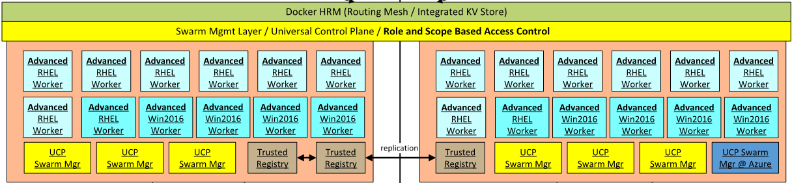
Docker Engine Orchestration Clusters
Docker Swarm
“A swarm is a group of machines that are running Docker and joined into a cluster. After that has happened, you continue to run the Docker commands you’re used to, but now they are executed on a cluster by a swarm manager. The machines in a swarm can be physical or virtual. After joining a swarm, they are referred to as nodes.”
- https://docs.docker.com/get-started/part4/

Slide 12
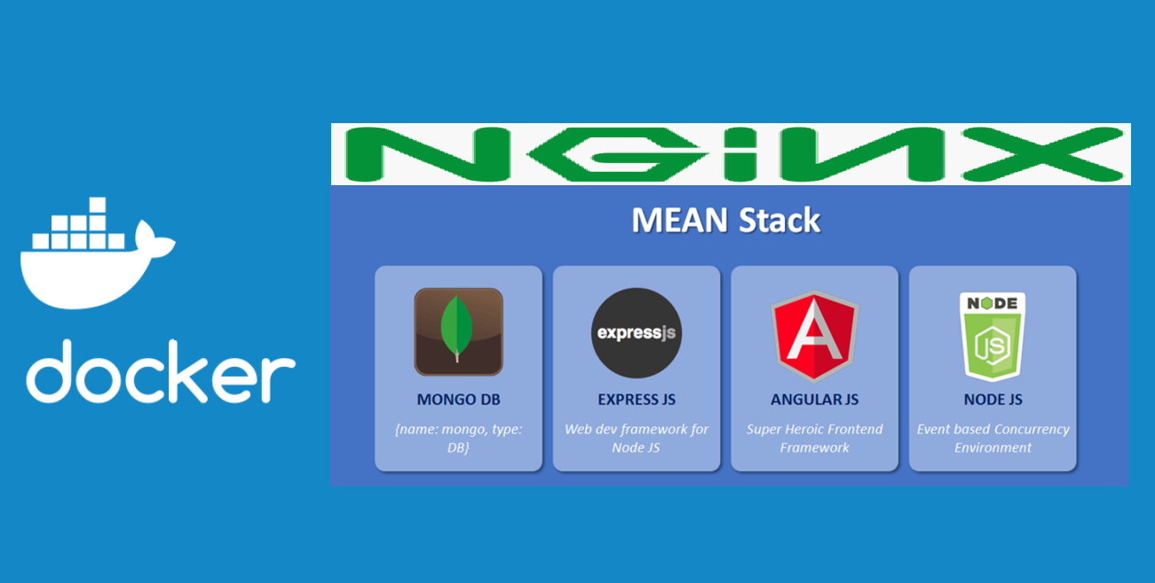
MEAN Demo Project Stack Architecture
NGINX – WebServer for static content, load balancer and proxy for dynamic content (https://hub.docker.com/_/nginx/)
MongoDB – Database (https://www.mongodb.com/)
ExpressJS – JavaScript back-end web framework (API - https://expressjs.com/)
AngularJS – JavaScript frontend framework for MVC (https://angularjs.org/)
NodeJS – JavaScript client runtime environment (https://nodejs.org/en/)

Slide 13
One MEAN CI/CD Docker Demo
Demo Developer System Specifications:
Windows 10 installed with Hyper-V active
Docker Desktop Installed
Git Installed (to clone the MEAN_Demo project and check in code)
https://github.com/jhuopensource/meandemo
Visual Studio Code Installed
Note:
The demo project and all Docker projects can run on any system running a Docker engine.
Use the editor of your choice.
Visit https://hub.docker.com to see all of the prepared images / stacks.
Works with any CI Automation Platform / Solution
MEAN Project Development can be performed in various ways:
Build and debug local -> package and run in container
Within docker container (see docker run node + volumes)
…

Slide 14
One MEAN CI/CD Docker Demo
Demo Production Deployment Specifications:
Linux Based AWS EC2 Server
Docker CE
Swarm Mode Enabled
Services
meandemo_mongo
meandemo_express_node
meandemo_nginx_angular_node
GitHub repo polling enabled through Travis
https://github.com/jhuopensource/meandemo
Note:
The demo project and all Docker projects can run on any system running a Docker engine.
Production environment specifications require added fault-tolerance.
Visit https://hub.docker.com to see all of the prepared images / stacks.
Works with any CI Automation Platform / Solution

Slide 15
One MEAN CI/CD Docker Demo
Activities:
Travis-CI (.travis.yml) walk-through
Docker Compose files walk-through
Code edit and commit to development (dev) branch of the MEANDEMO GitHub repo.
Follow Travis-CI execution log and review result
Manual testing scenario execution / review
Lint
Selenium
Enter a GitHub Pull request (dev -> stage)
Follow Travis-CI execution log and review result
Merge branch dev -> stage
Follow Travis-CI execution log and review result
Enter a GitHub Pull request (stage -> prod)
Follow Travis-CI execution log and review result
Merge branch stage -> prod
Follow Travis-CI execution log and review result
Review docker hub registry
Examine the Swarm
Simulated failure
Lint
Selenium

Slide 16
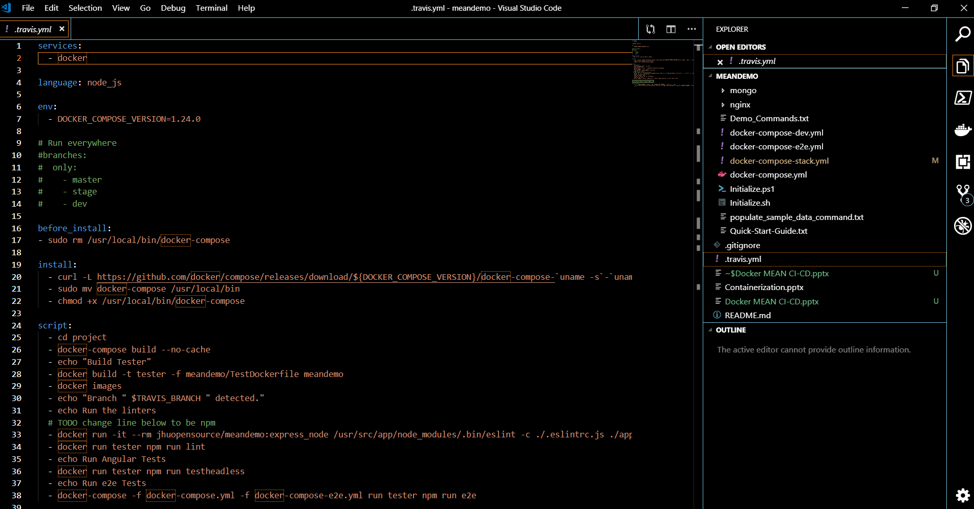
One MEAN CI/CD Docker Demo Travis-CI (.travis.yml) walk-through

Slide 17
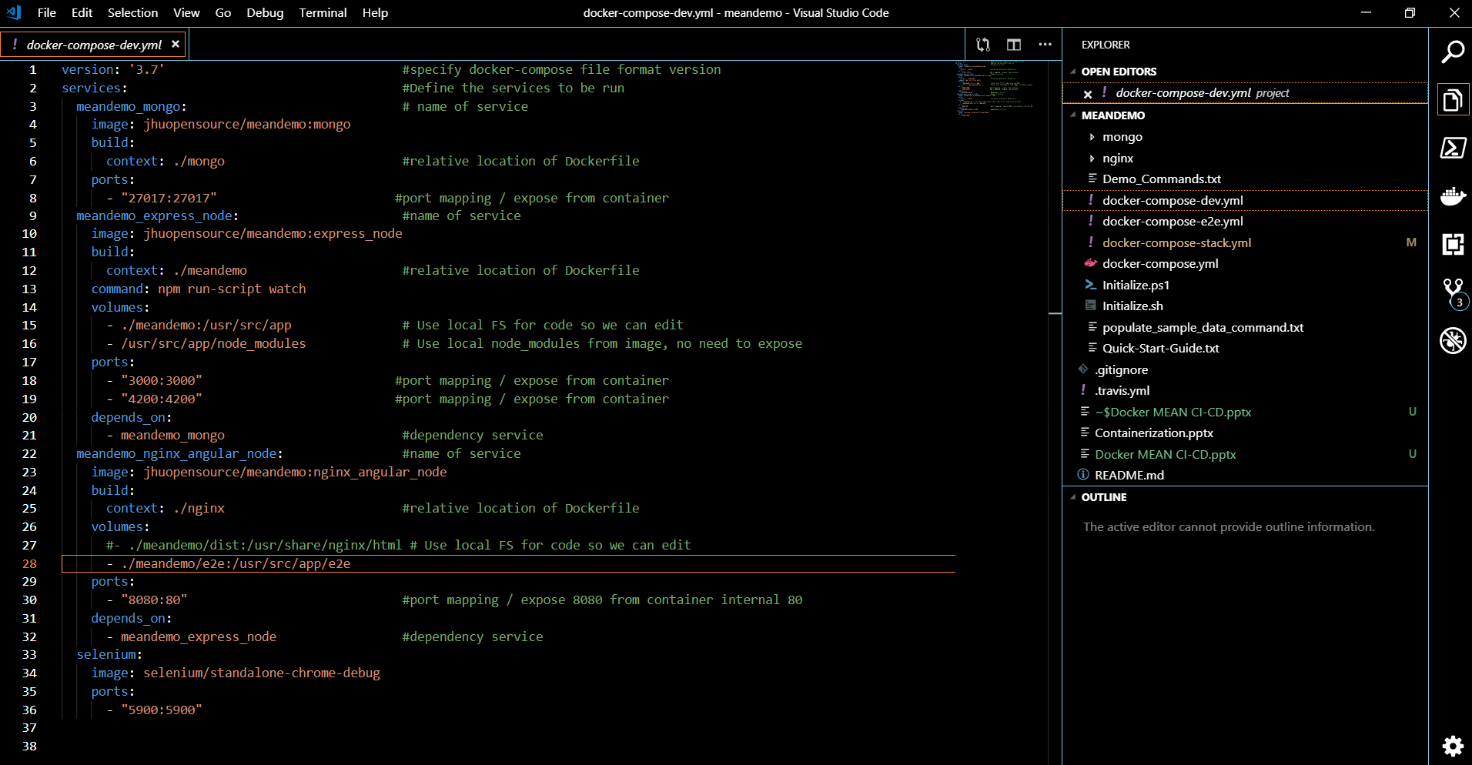
One MEAN CI/CD Docker Demo Docker Compose files walk-through

Slide 18
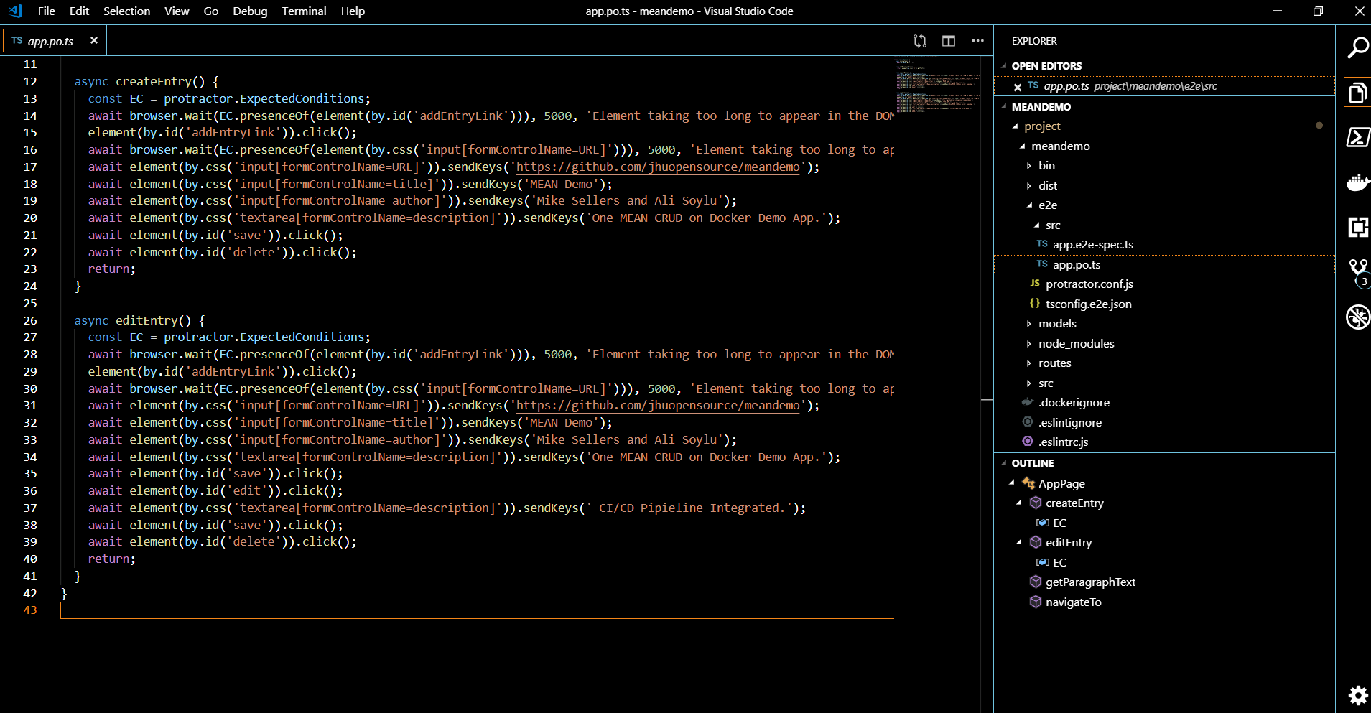
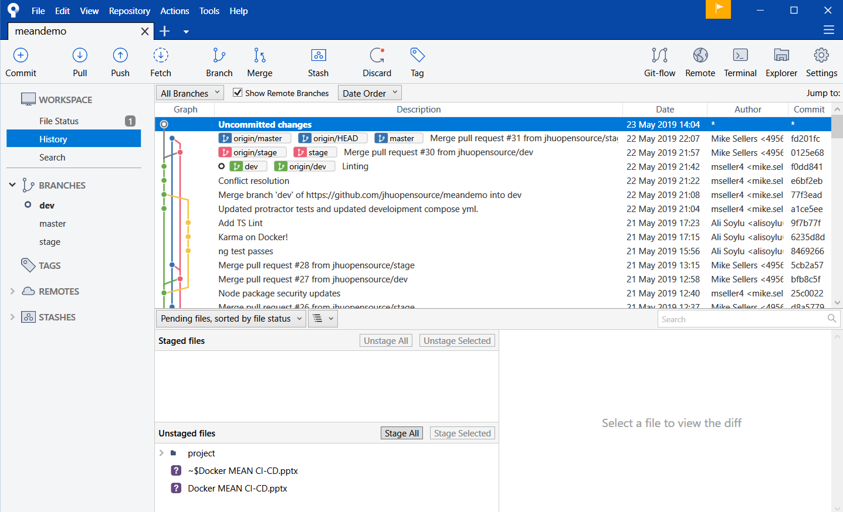
One MEAN CI/CD Docker Demo Code edit and commit to development (dev) branch of the MEANDEMO GitHub repo

Slide 19
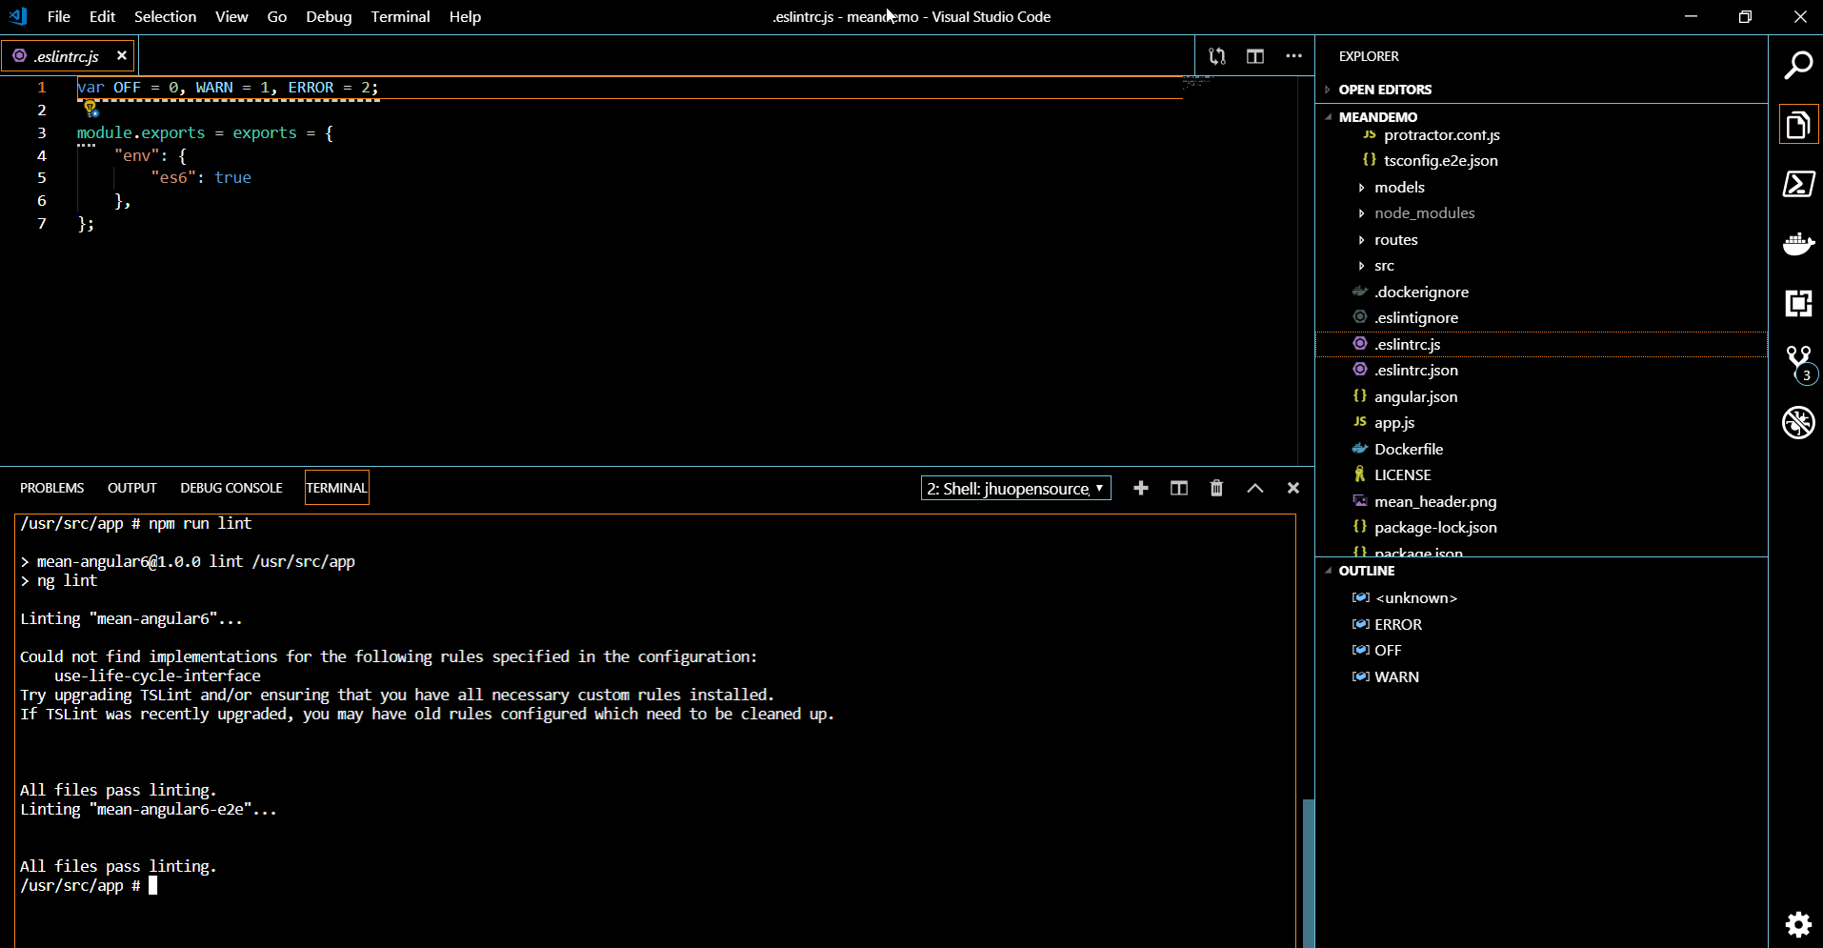
One MEAN CI/CD Docker Demo - Linting Manual testing scenario execution / review

Slide 20
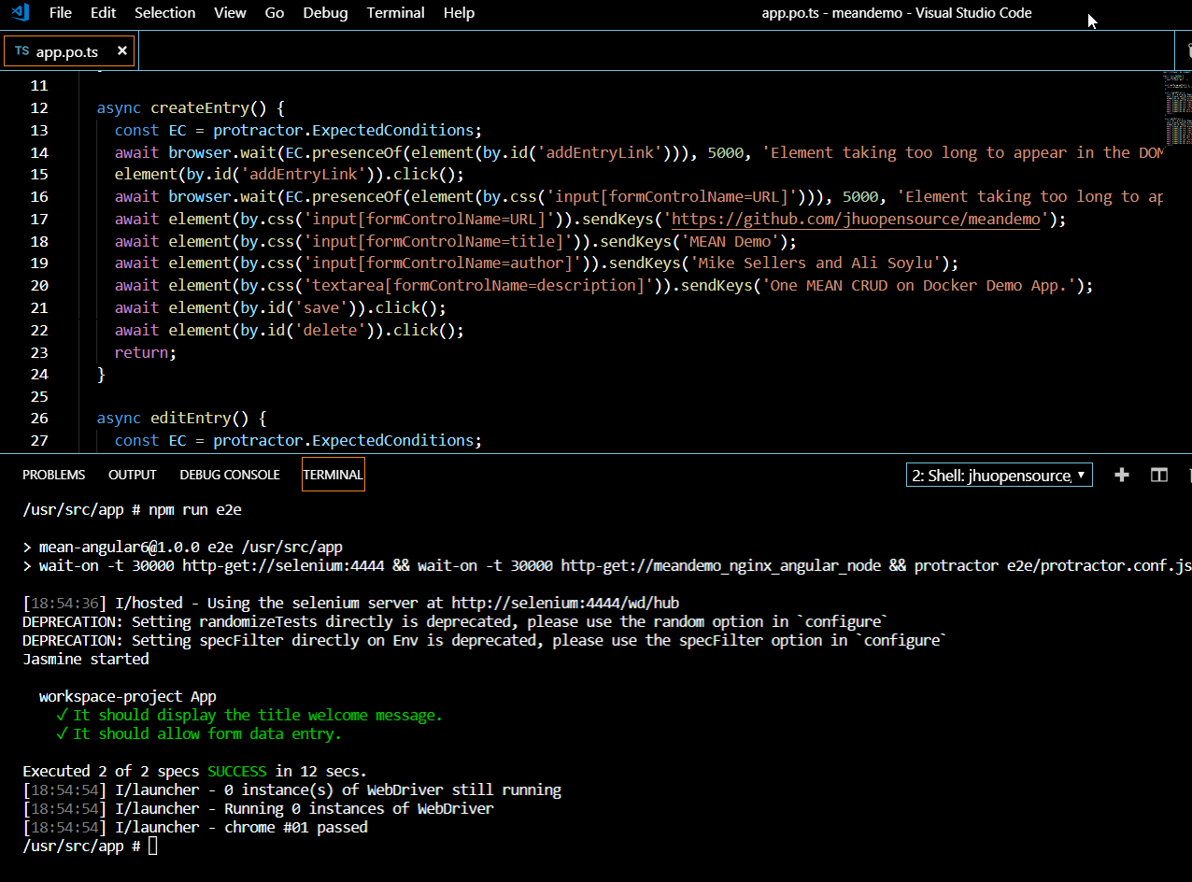
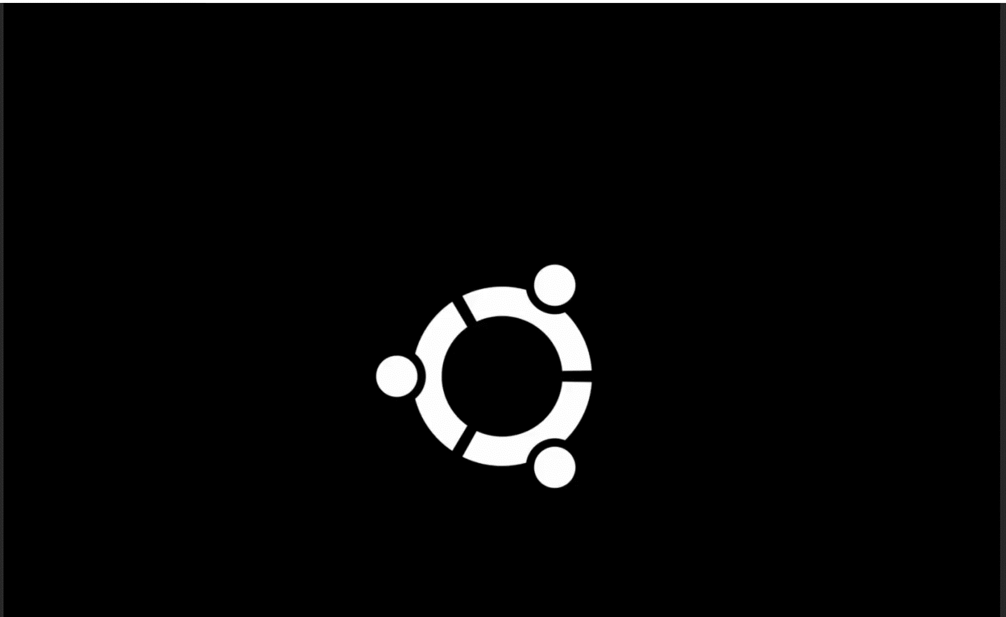
One MEAN CI/CD Docker Demo - Selenium Manual testing scenario execution / review

Slide 21
One MEAN CI/CD Docker Demo - Selenium Enter a GitHub Pull request (dev -> stage)

Slide 22
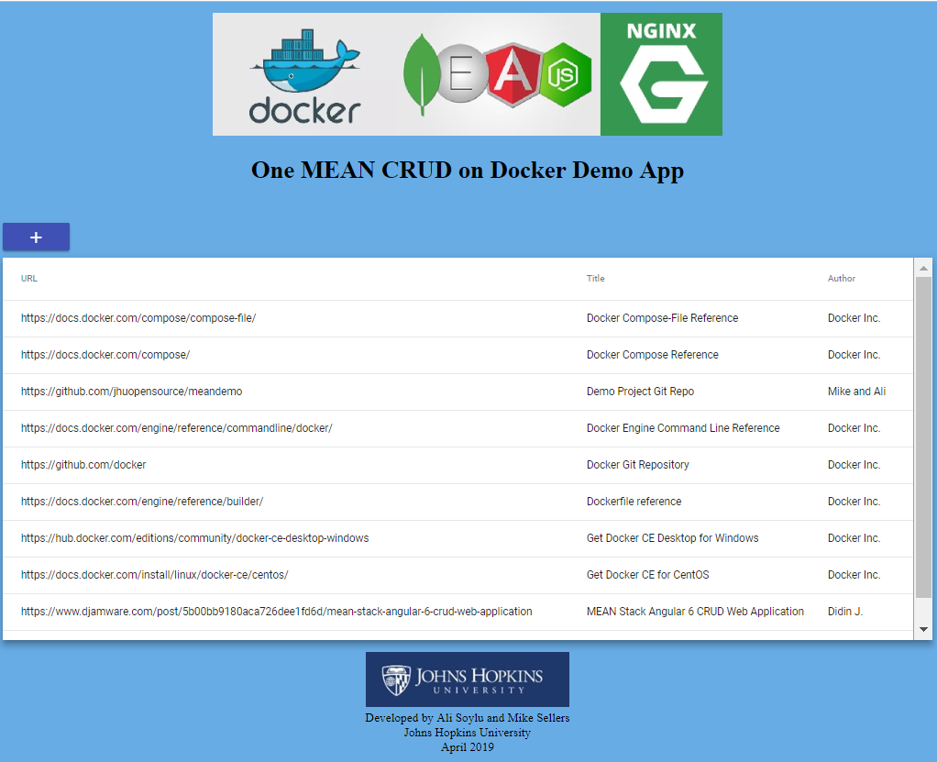
Docker Demonstration
Visit the production copy of the demo application by browsing:
http://meandemo.sis.jhu.edu

Slide 23
Useful URLs
----------------------------------------------------------------------------------------------------------
Demo Project Git Repo - https://github.com/jhuopensource/meandemo
-----------------------------------------------------------------------------------------------------------------------------
Docker Compose-File Reference - https://docs.docker.com/compose/compose-file/
Docker Compose Reference - https://docs.docker.com/compose/
Docker Engine Command Line Reference - https://docs.docker.com/engine/reference/commandline/docker/
Docker Git Repository – https://github.com/docker
Docker Hub – https://hub.docker.com
Dockerfile reference - https://docs.docker.com/engine/reference/builder/
Get Docker CE Desktop for Windows - https://hub.docker.com/editions/community/docker-ce-desktop-windows
Get Docker CE for CentOS - https://docs.docker.com/install/linux/docker-ce/centos/

Slide 24
Containerized MEAN Stack Development through a CI/CD pipeline
Thank You!
Mike Sellers - Container Zealot and Senior Software Engineer
Ali Soylu – Developer and IT Architect
Johns Hopkins University

